Slide 2
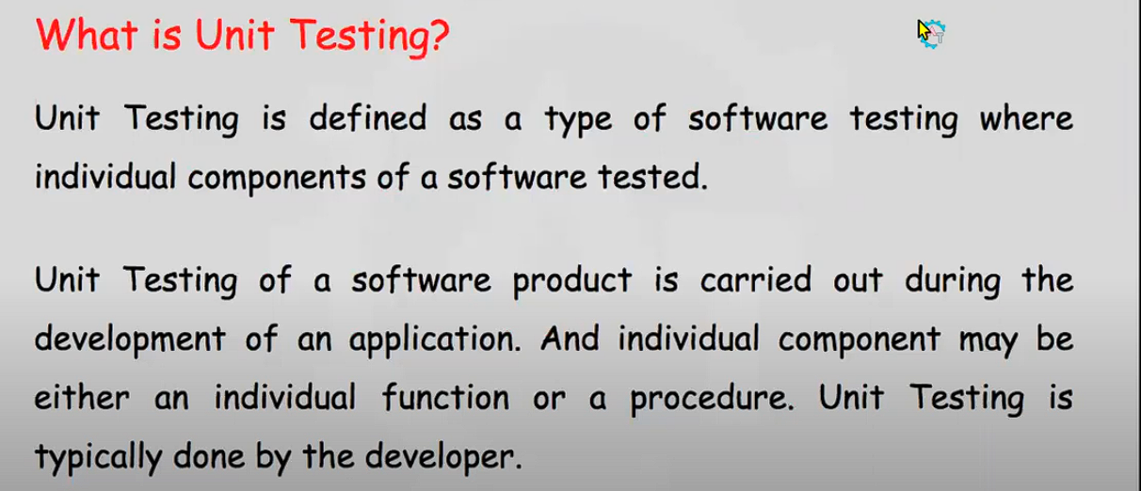

Slide 3
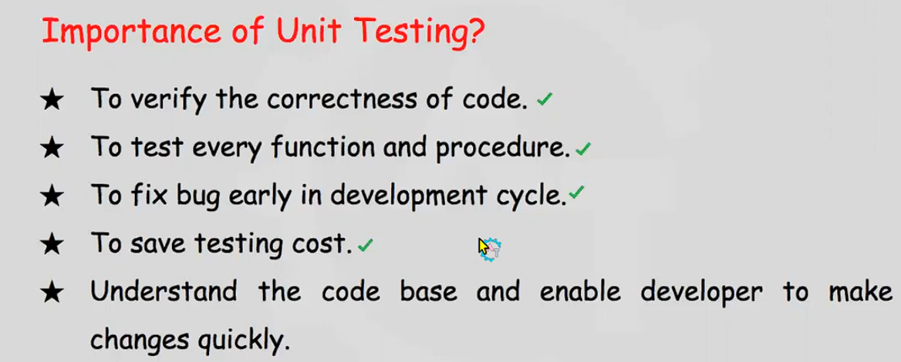

Slide 4
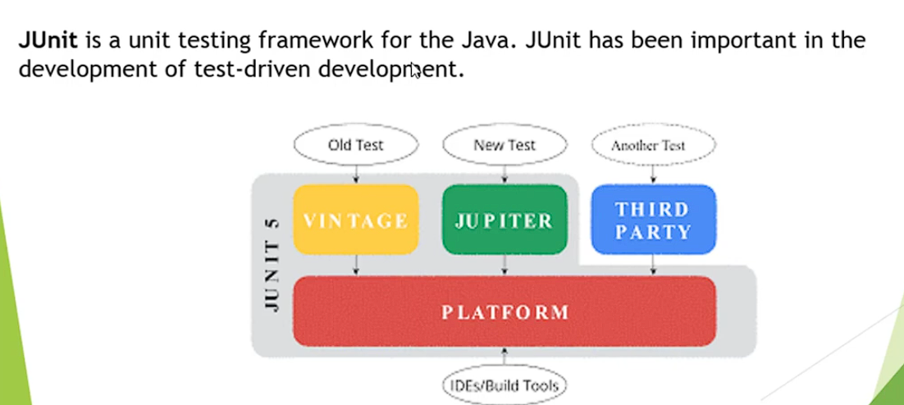

Slide 5
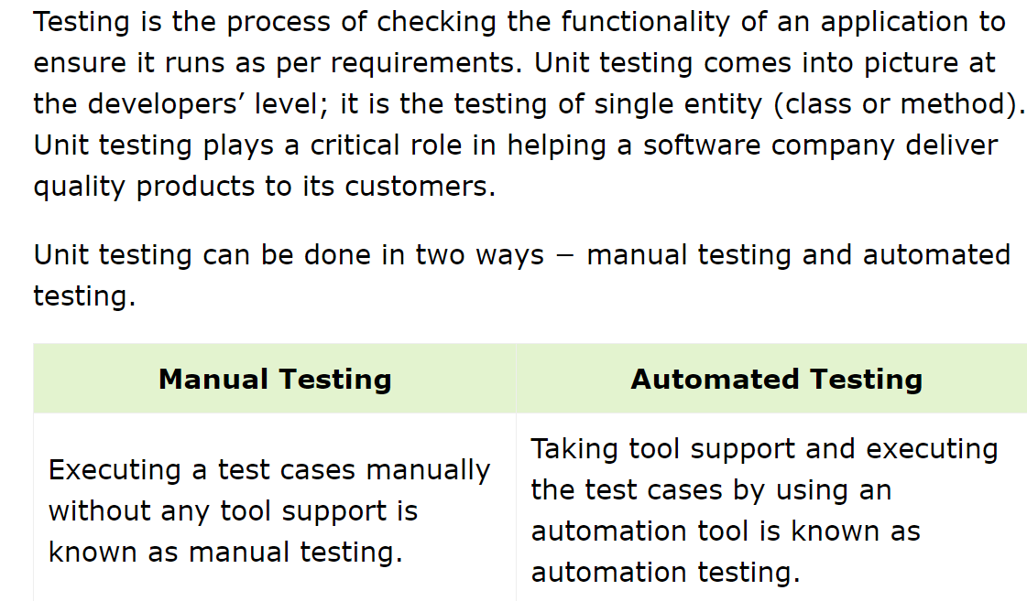

Slide 6
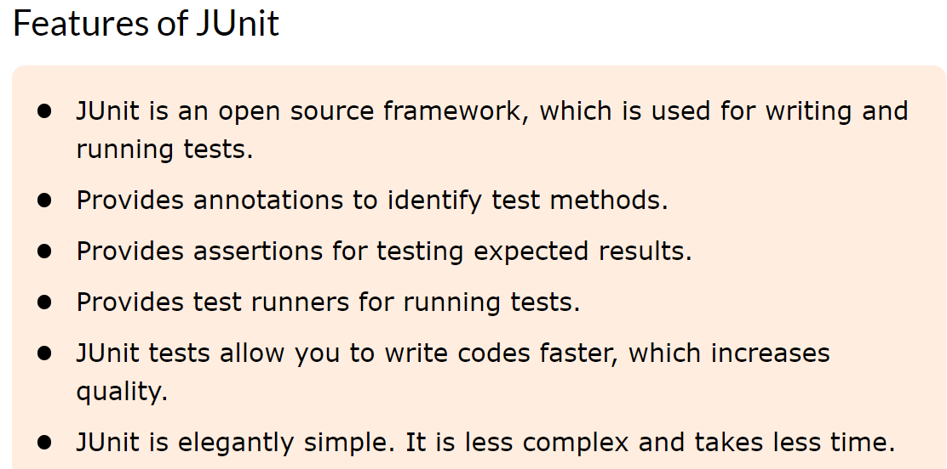

Slide 7
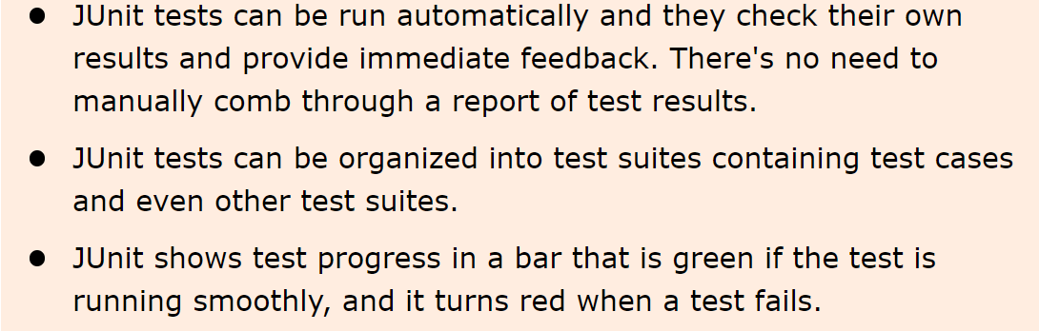

Slide 8
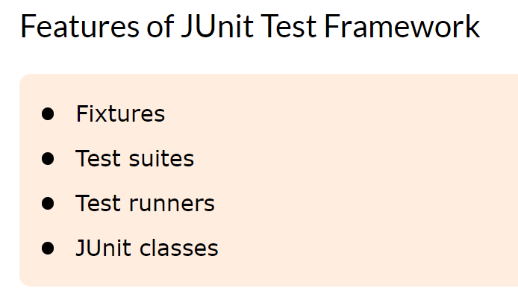

Slide 9
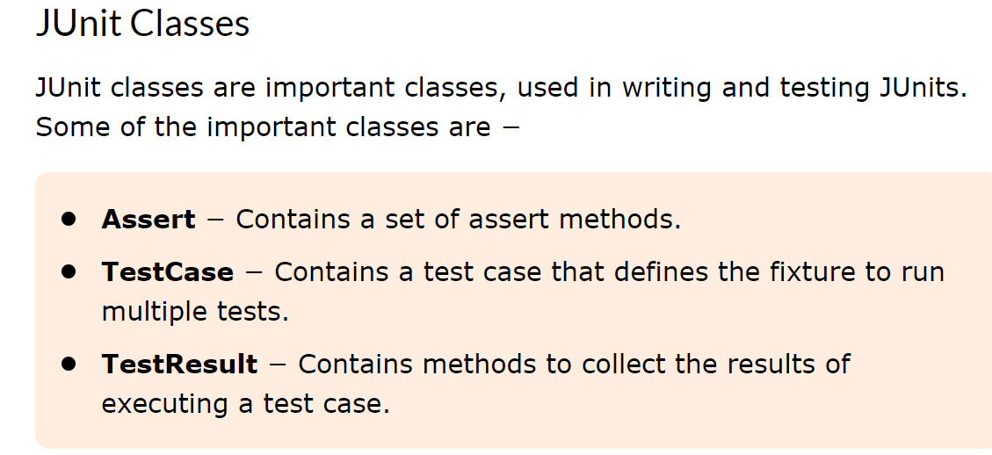

Slide 10
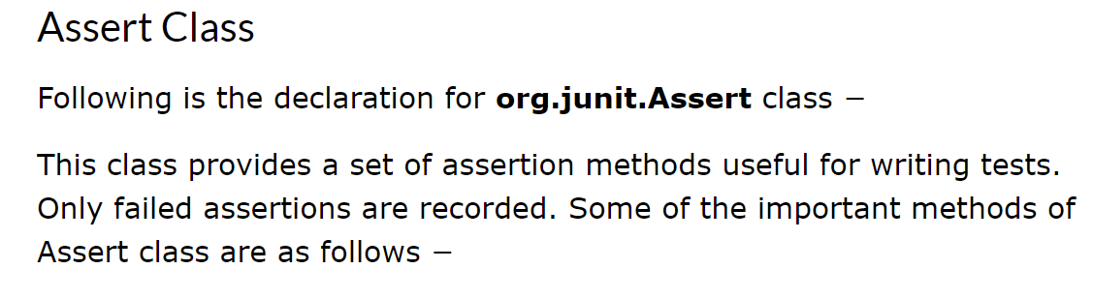

Slide 11
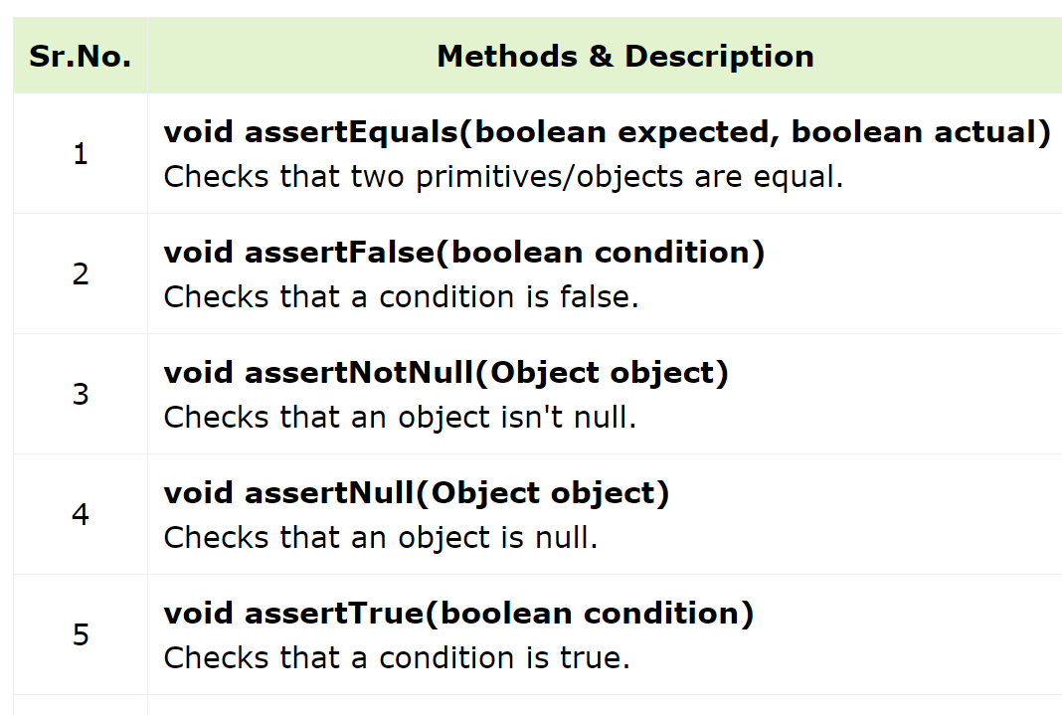

Slide 12
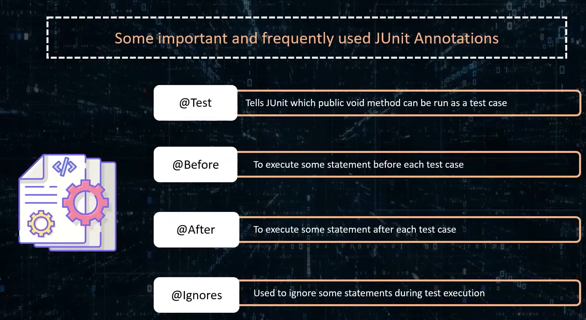

Slide 13
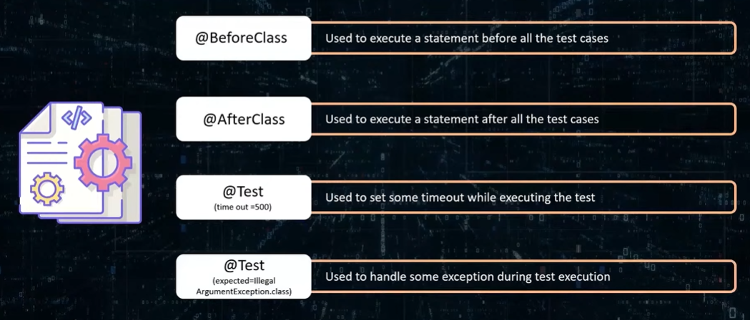

Slide 15


Slide 16


Slide 17
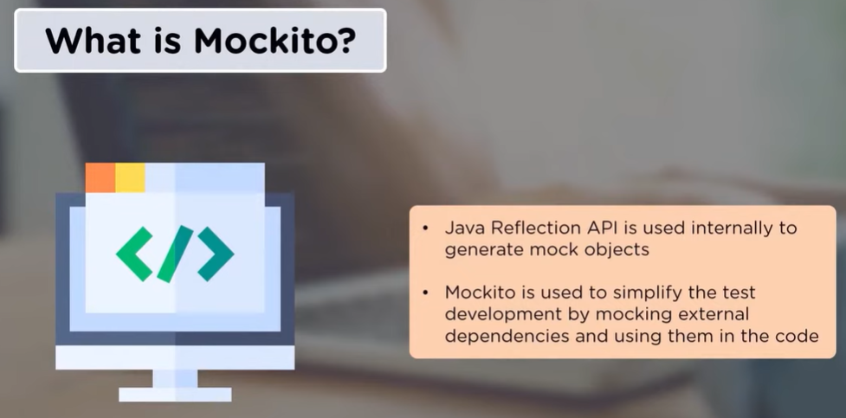

Slide 18
Mockito is a java based mocking framework, used in conjunction with other testing frameworks such as JUnit and TestNG.
It internally uses Java Reflection API and allows to create objects of a service.
A mock object returns a dummy data and avoids external dependencies.
It simplifies the development of tests by mocking external dependencies and apply the mocks into the code under test.

Slide 19
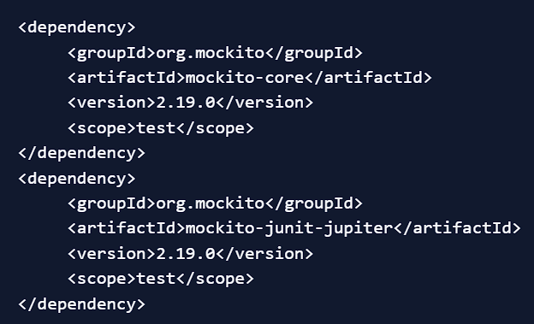
Mockito Maven Dependencies

Slide 20
Mockito Mock Creation
The Mockito framework allows us to create mock objects using either @Mock annotation or mock() static method.
@Mock creates a mock instance of the class.
verify is used to verify that the method add was called with the argument "test".

Slide 21
@InjectMocks
The @InjectMocks annotation is used to inject mock objects into the class being tested. It helps to automatically inject all the mocks marked with @Mock or @Spy into the tested object.
@ExtendWith
The @ExtendWith annotation is used to register extensions in JUnit 5. For Mockito, it is used to initialize Mockito annotations.
@Spy
The @Spy annotation is used to create a spy of a real object. Spies allow partial mocking, where you can mock some methods while using real implementations for others.

Slide 22
@Captor
The @Captor annotation is used to create an argument captor, which captures argument values passed to mocked methods.

